Slide 1
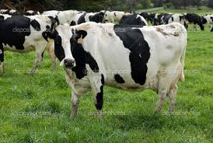
DAIRY FARMING

Slide 2
DAIRY FARMING
Livestock plays a vital role in the socio-economy of the state and dairy development needs to be primary consideration which provides reliable sources of income to unemployed educated youth and rural people, thereby promoting sustainable development through dairy farming.

Slide 3
Milk is the universal diet and a source of animal protein for human and help combating malnutrition. In recent past there is an unprecedented rise in the demand of milk in all parts of this state mainly due to drastic reduction of natural availability of protein of animal origin, population explosion and nutritional awareness etc. Since the milk demand is high, the farmers can make quick income generation from milk and also from manure, gunny bags and selling of male calves.

Slide 4
The dairy farming also help making judicious utilization of land. The manure from dairy farm will boost agriculture and horticulture production and productivity from less area and also will act as integrator by preventing land degradation.

Slide 5
TECHNICAL ASPECTS –
CONSTRUCTION AND CLEANLINES OF SHED –
Cow shed should be constructed on dry and raised ground.
The wall should be 1.5 to 2 meters high and the roof should be 4 meters high.
The floor should be pucca, well sloped (3 cm per mtr) with proper drainage to maintain dry and clean. The drain should be 0.25 meters broad at the rear of the standing space.
Each animal required 2 x 1.05 mtrs standing space.

Slide 6
Feeding trough, manger, drain and wall should be rounded for easy cleaning.
The shed should be well ventilated, provide cool drinking water in summer.
Spray the pen and shed with malathion or copper sulfate solution to control external parasites
Proper disposal of dung and urine. A Gobar gas plant can be useful.
Give adequate space for the animals as per age, breed etc.

Slide 7
SPACE REQUIREMENT (Mtr)
Age group | Manger space (mtr) | Standing or covered area (Sq.m) | Open space (Sq.m)
4 – 6 months | 0.2 – 0.3 | 0.5 – 1.0 | 3.0 – 4.0
6 – 12 months | 0.3 – 0.4 | 1.2 – 1.6 | 5.0 – 6.0
1 – 2 yrs. | 0.4 – 0.5 | 1.6 – 1.8 | 6.0 – 8.0
Cows | 0.8 – 1.0 | 1.8 – 2.0 | 11.0 – 12.0
Pregnant cows | 1.0 – 1.2 | 8.5 – 10.0 | 15.0 – 20.0
*Bull | 1.0 – 1.2 | 9.0 – 11.0 | 20.0 – 22.0
*Housed individually

Slide 8
SELECTION OF ANIMALS –
1. Purchase the animals from reliable breeder or from nearest livestock market with help of technical officer.
2. Select high yielding, healthy freshly calved animals in their second or third lactation. Ascertain milk yield by milking the animals 2-3 times consecutively.
3. Vaccinate and identify the newly purchased animals by giving identification mark.
4. Cull the old animals after 7th lactation

Slide 9
FEEDING OF MILCH ANIMALS -
Give adequate green fodder and best feeds.
Grow fodder on land as per as possible and cut the fodder at the right age stage of their growth.
The oil cake should be flaky and clumpy.
Moisten the concentrate mixture before feeding.
Provide adequate vitamins, minerals, salt and clean water.
To estimate the daily feed requirement, remember that the animals consume about 2.5 to 3.0 percent of their body weight on dry matter basis.

Slide 10
FEEDING SCHEDULED (Kg)
S.No. | Animal producing milk | Feeding during | Green fodder | Dry fodder | Conc. feeds
1. | 6 – 7 litres/day | Lactation days Dry days | 20 - 25 15 - 20 | 5 - 6 6 - 7 | 3 - 3.5 0.5 - 1.0
2. | 8 – 10 litres/day | Lactation days Dry days | 25 – 30 20 – 25 | 4 – 5 – 8 | 4.0 – 4.5 0.5 – 1.0

Slide 11
MILKING OF COWS –
Milk at the fixed times for 2 – 3 a day depend upon production.
Milking should be done by same person regularly in clean place within eight minutes in one sitting.
Wash the udder and teat with luke warm water and dry before milking.
Milking should be done with full hands quickly and completely followed by stripping. Sick cows should be milked at the end to prevent spread of infection.

Slide 12
PROTECTION AGAINST DISEASE –
Consult the nearest veterinary dispensary for help if illness is suspected like reduced feed intake, fever, abnormal discharge or unusual discharges etc.
Wash the animal regularly from time to time to promote sanitation.
Periodic pre-monsoon and post monsoon vaccination should be conducted against FMD, HS and BQ. etc.

Slide 13
BREEDING CARE –
Observe the animal closely and keep specific record of its coming in heat, duration of heat, insemination, conception and calving.
The onset of estrous will be 60 – 80 days after calving.
Breed the animal on time which will help to achieve conception within 2 – 3 months of calving.
Use high quality of semen preferably frozen semen of proven bulls and breed the animals when it is in peak i.e 12 to 24 hours of heat.

Slide 14
CARE DURING PREGNANCY –
Give special attention to pregnant cows two months before calving by providing adequate space, feed, water etc.

Slide 15
CARE OF CALVES –
Feed colostrums to calf
Assist the calf to suckle if is too weak to suckle on its own within 30 minutes of calving.
Disinfect the naval cord with tincture iodine as soon as it is cut with a sharp knife.
Protect the calves against extreme weather condition particularly during first two months.
Dispose off calves not to be reared for any specific purposes as early as possible, particularly male calves. The female calves should be reared properly.

Slide 16
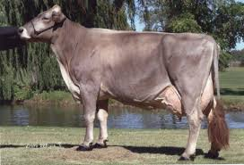
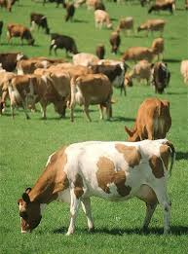
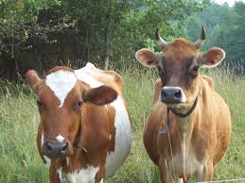
THANK YOU

